Slide 1
Documentation for Pocket Plane App Final Version
Group Name: Echipa Racheta
Barbu Mircea-Alexandru CEN 3.1
Efrem Ion-Ștefan CEN 3.1
Hagiu Teodora-Adriana CEN 3.1
Mitre Flavia-Antonia CEN 3.1
Instructor: Stoica Spahiu Cosmin
Course: Project II – Use of Databases

Slide 2
Client Part
Functionalities and pages:
Client Home
Edit Account
Search Flights
Buy Ticket
See Reservations

Slide 3
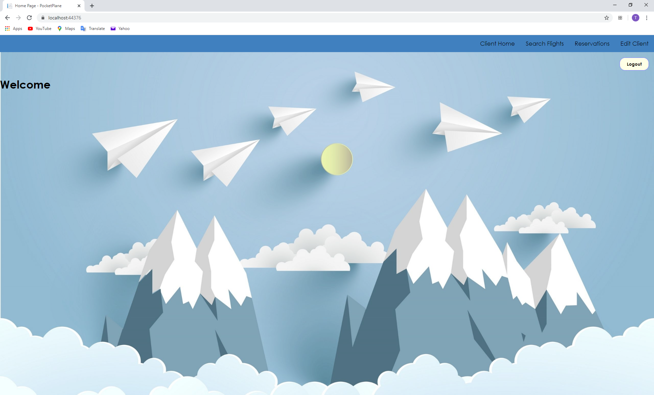
Client Home Page
The client home is the page where the client is sent after a successful login. The client can navigate to: home page, edit client, search flights or reservations page.

Slide 4
Search Flights
At first all the existing flights are displayed.
On this page, the client can perform a search by: flightNO, business price, departure city or arrival city, by selecting one of the items from the list and entering a value (example: the client selects „Departure City”, enters the string: „Craiova” and presses the search button. All the flights that have the departure city „Craiova” are shown).
Clicking the „Search” button performs a search by the selected criteria on the whole list of flights, and shows a new page containing only the flights that meet the selected criteria.
The flights are displayed as a table containing all the details, and a buy ticket button for every of them.

Slide 5
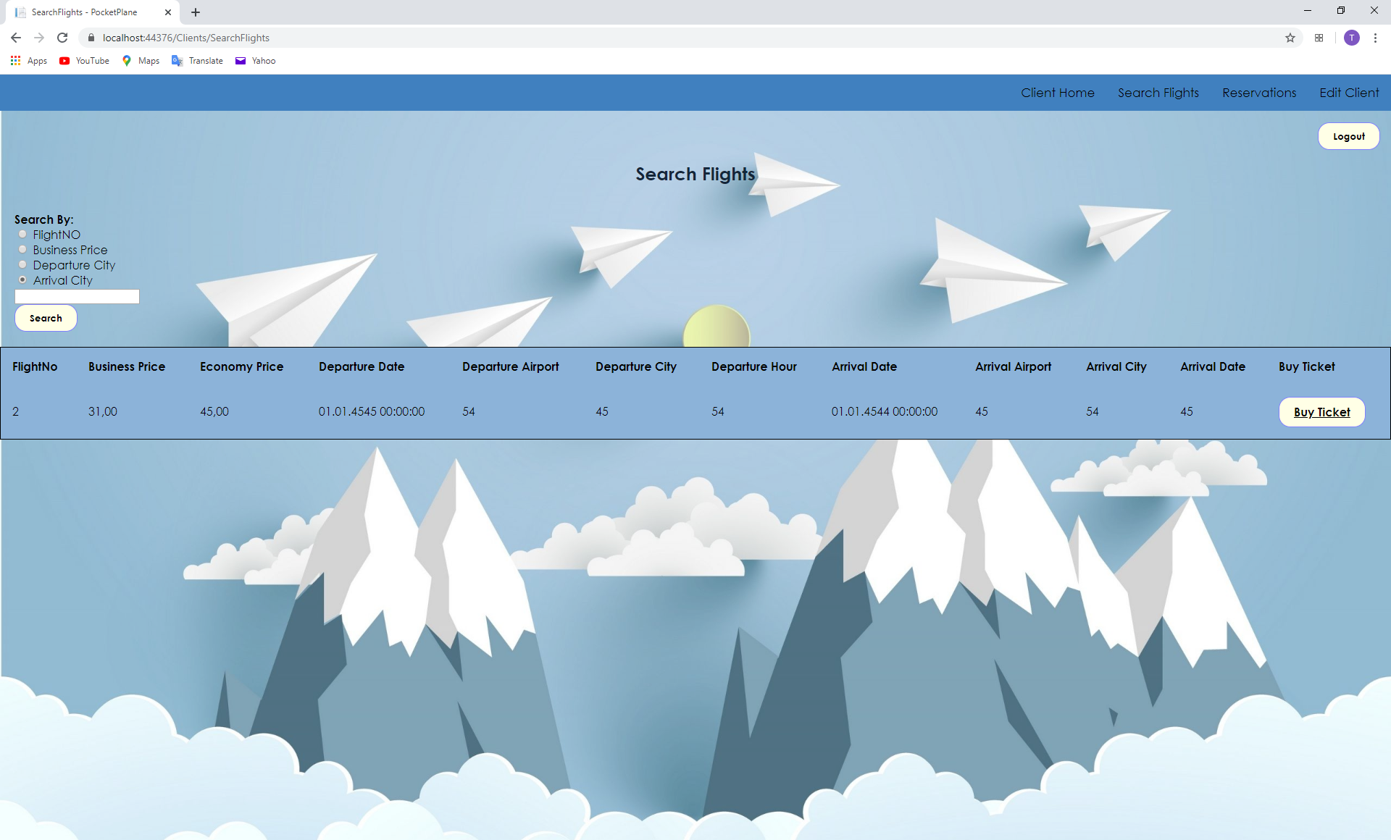
Search Flights

Slide 6
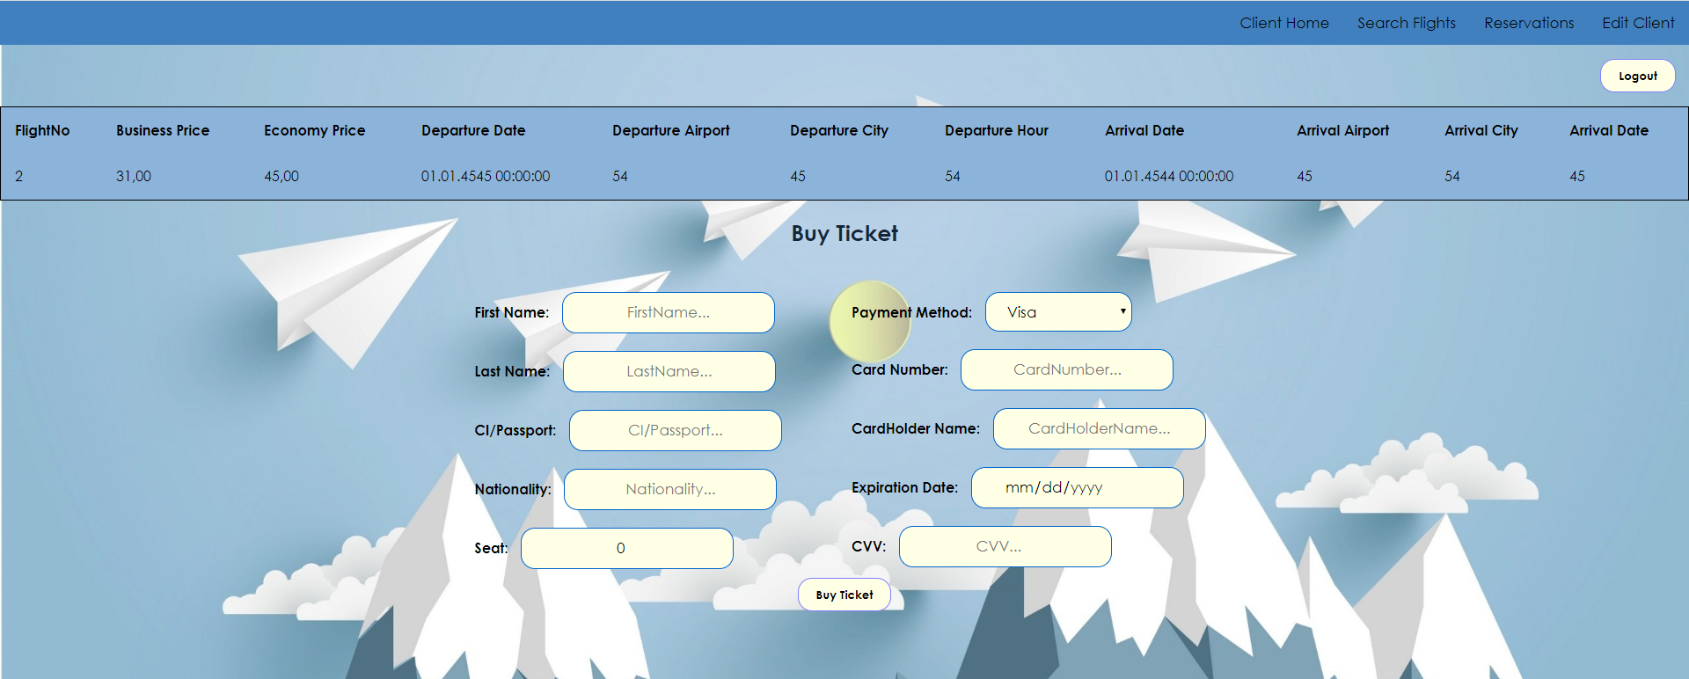
Buy Ticket Page
This page shows the details for the selected flight as a table
There are some fields that must be completed în order to make a reservation to a flight and buy a ticket
Completing all the fields and clicking the „Buy Ticket” button are all the steps necessary for a customer to insure his place on a flight.

Slide 7
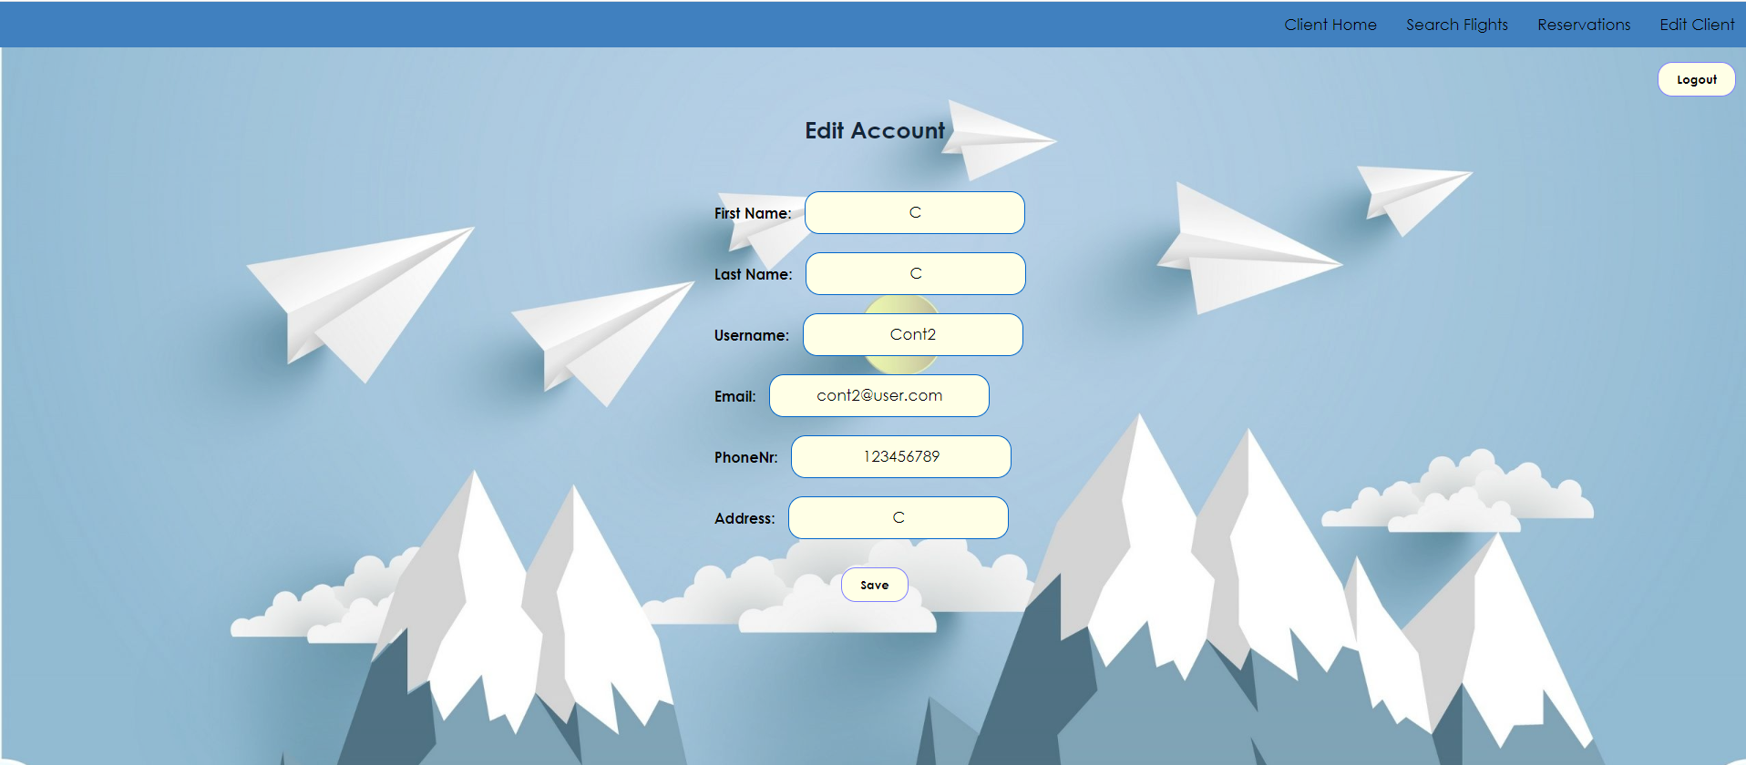
Edit-client On this page the client is able to change some of the data from register, as first and last name, his username, email, phone number and address.

Slide 8
Reservations Page
This page displays all the reservations made by the client that is logged in.
Details for the ticket holder:
last name
first name
nationality
passport or CI
the chosen seat
The client can buy tickets for other people, the ticket holder can be anyone, not just the client itself.

Slide 9
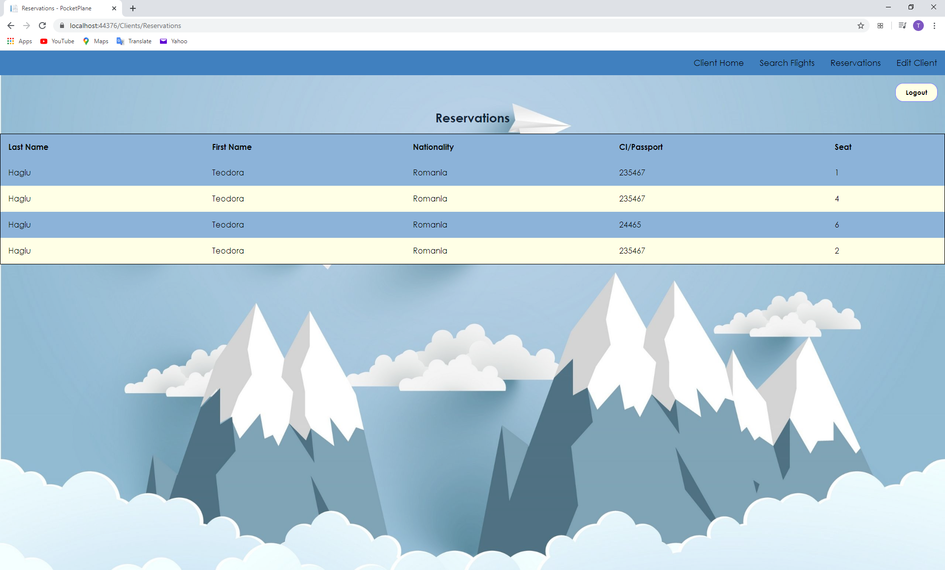
Reservations Page

Slide 10
Administrator Part
Functionalities and pages:
Admin Home
Add Plane Type
Plane Types
Add Flight
Future Flights
Past Flights
Edit Admin

Slide 11
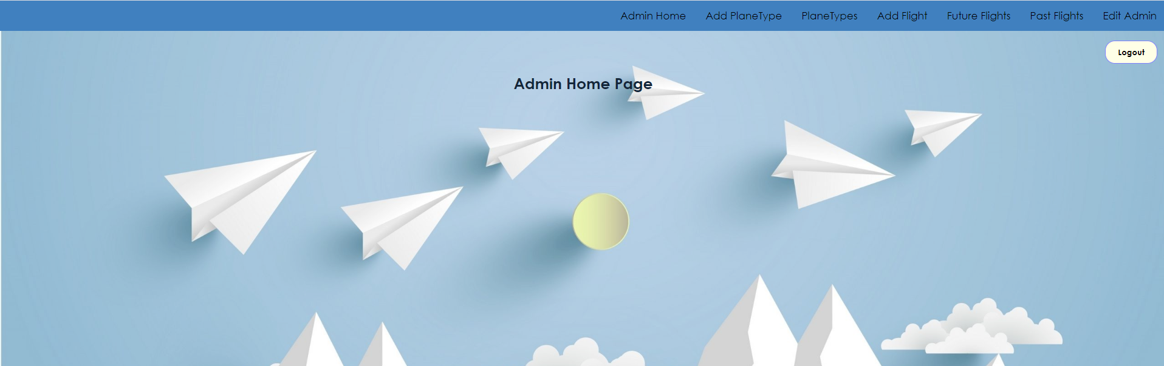
Admin Home Page
The admin home is the page where the admin is sent after a successful login. The admin can navigate to: home page, add plane type, plane types, add flight, future flights, past flights and edit admin.

Slide 12
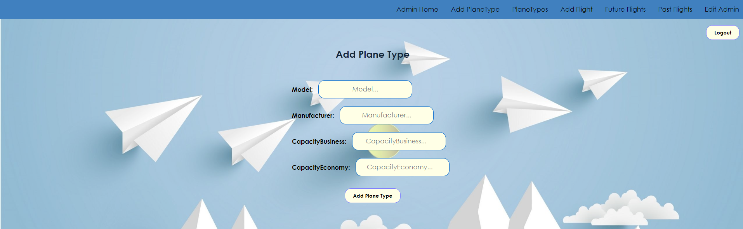
Add Plane Type Page
This page allows the admin to add a plane type, it contains the labels he needs to complete: model, manufacturer and the capacity for business and economy.
At the end there is the add plane button.

Slide 13
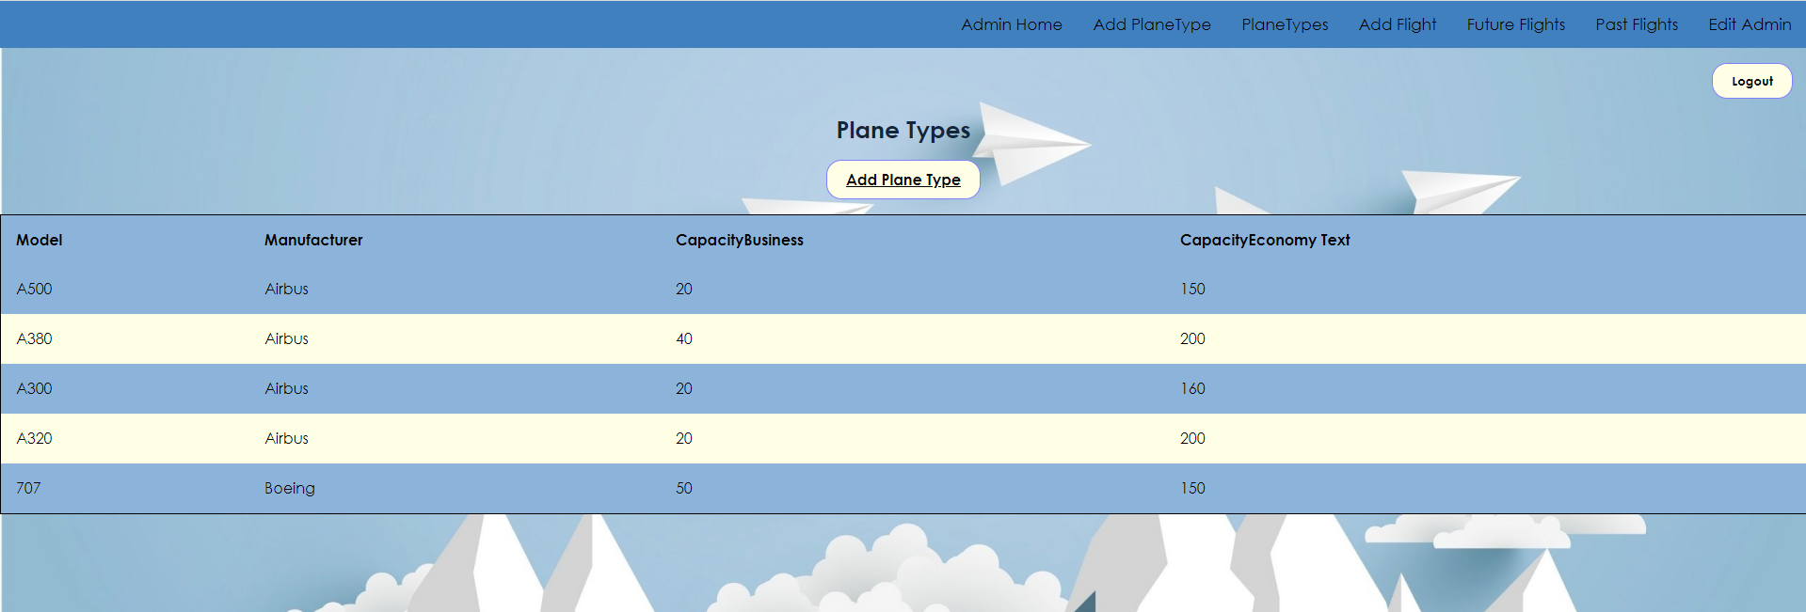
Add Plane Type Page
This page shows a table of plane types with all their attributes.
Above the table it also contains the button add plane type that redirects the admin to the add plane type page.

Slide 14
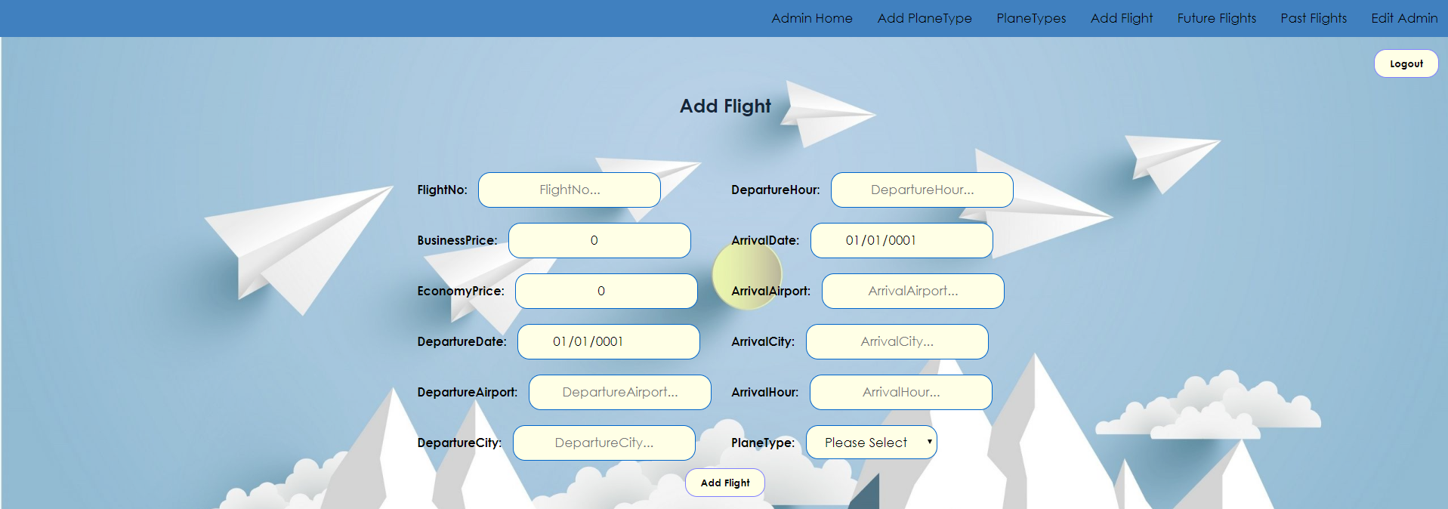
Add Flight Page
This page allows the admin to add a flight, it contains the labels he needs to complete and it also lets him choose which plane type he needs for the flight.
At the end there is the add plane button.

Slide 15
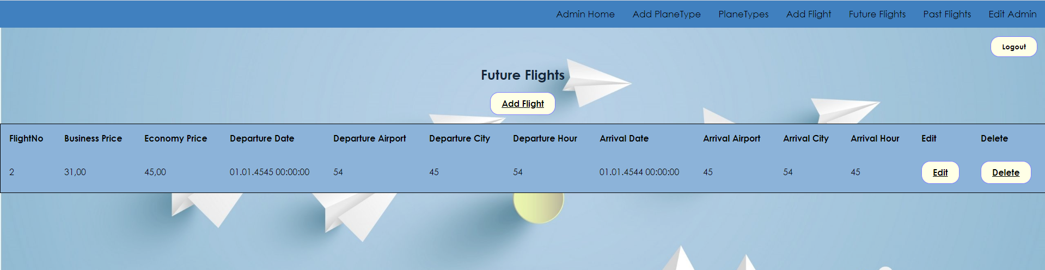
Future Flights Page
This page shows a table of the future flights with all their attributes. It also contains an edit button and a delete button.
Above the table it also contains the button add flight that redirects the admin to the add flight page.

Slide 16
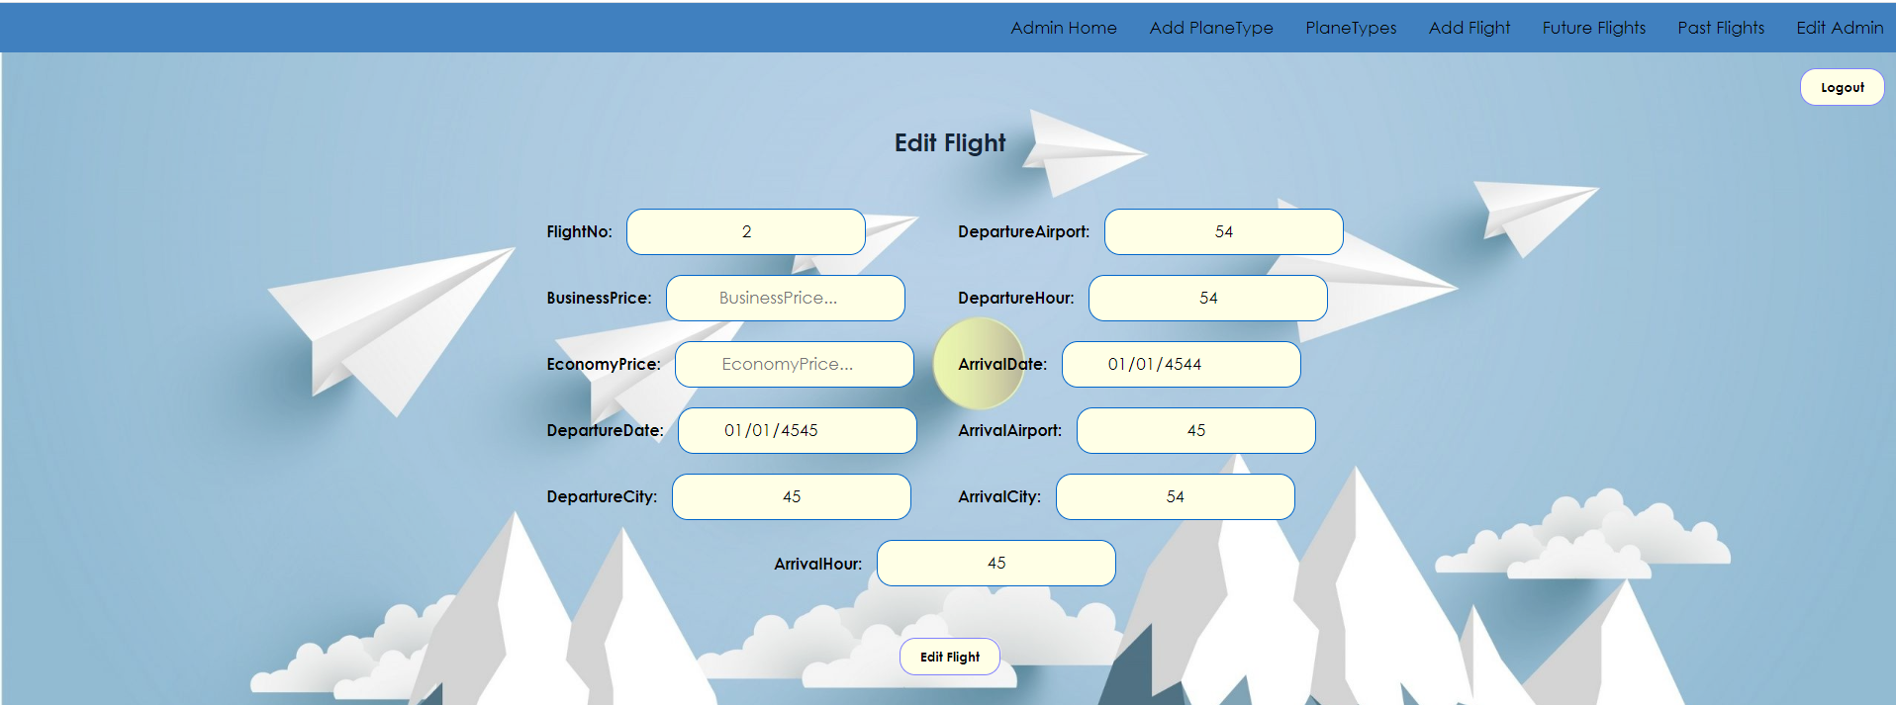
Edit Flight Page
This page allows the admin to edit a flight, it contains the labels that he can modify.
At the end there is the edit flight button.

Slide 17
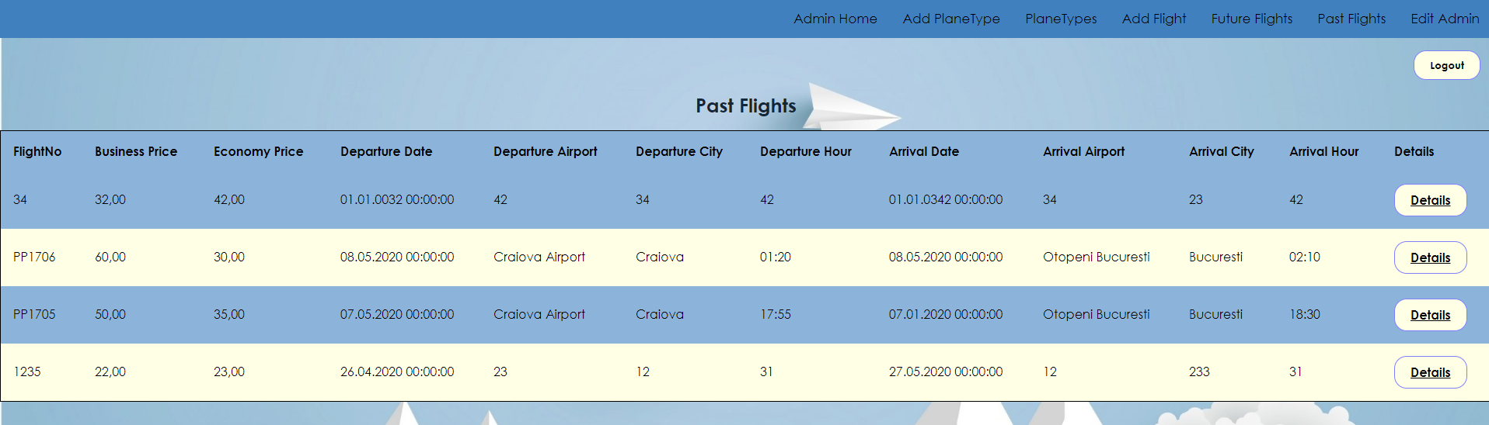
Past Flights Page
This page shows a table of the past flights with all their attributes. It also contains a details button that gives access to the list of reservations of that flight.
Above the table it also contains the button add flight that redirects the admin to the add flight page.

Slide 18
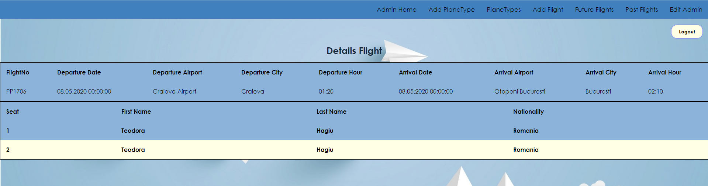
Details Page
At the top it shows the details of the chosen flight and under that we have a table of all the reservations in that flight (because of coronavirus there are only two).

Slide 19
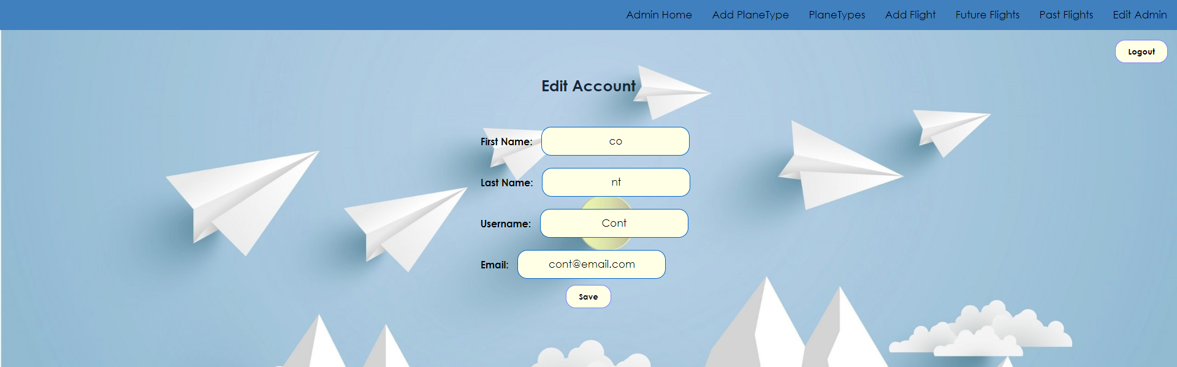
Edit Admin
On this page the admin is able to change some of their data as the first and last name, username and email.

Slide 20
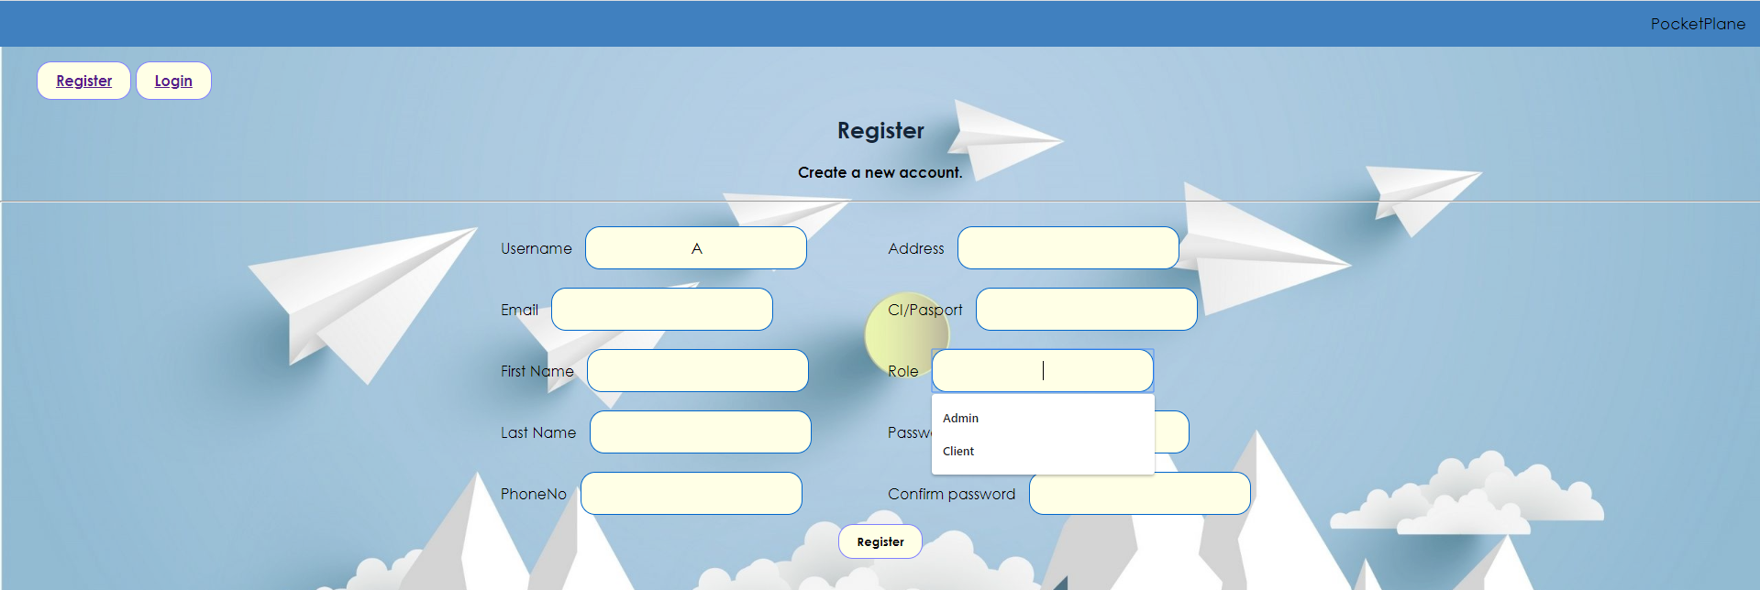
Register Admin
This page contains all the information needed for a registration,with restrictions for the username to be unique and the password (all those annoying constraints, uppercase, lower case, number, character and min of 6 length).

Slide 21
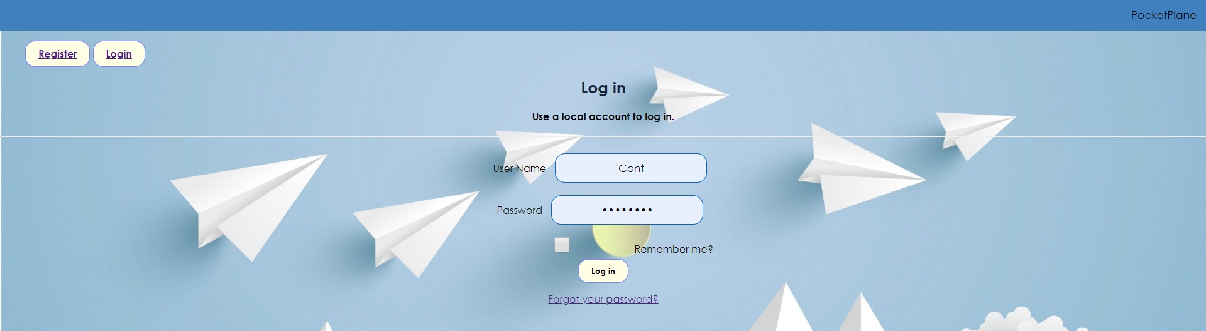
Login
The login page with username, password, login, remember me and link to forgot password page button and access to the register button in the left upper corner.

Slide 22
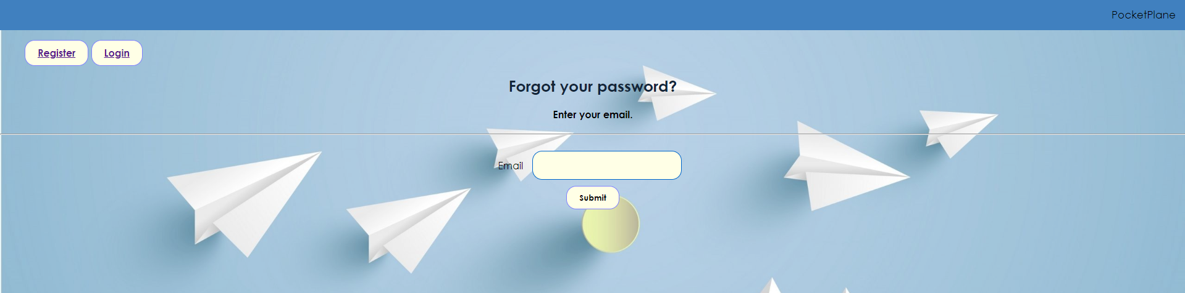
Forgot Password Page
Page in case you forgot your password, needs only the email for sending further instructions.

Slide 23
Pentru a rula aplicatia este necesar sa copiati fisierele cu extensiile .mdf si .ldf si sa le adaugati in partitia C -> Users -> Folderul cu numele userului (nu folderul “Public”). Apoi aplicatia se poate rula din visual studio.
Pentru a deschide solutia se da click dreapta pe fisierul “PocketPlane.sln” din folderul “PocketPlane” din folderul “Pocket Plane VFinala”, open with -> Visual Studio.

